Slide 1
Chapter 14
Reaction Mechanisms

Slide 2
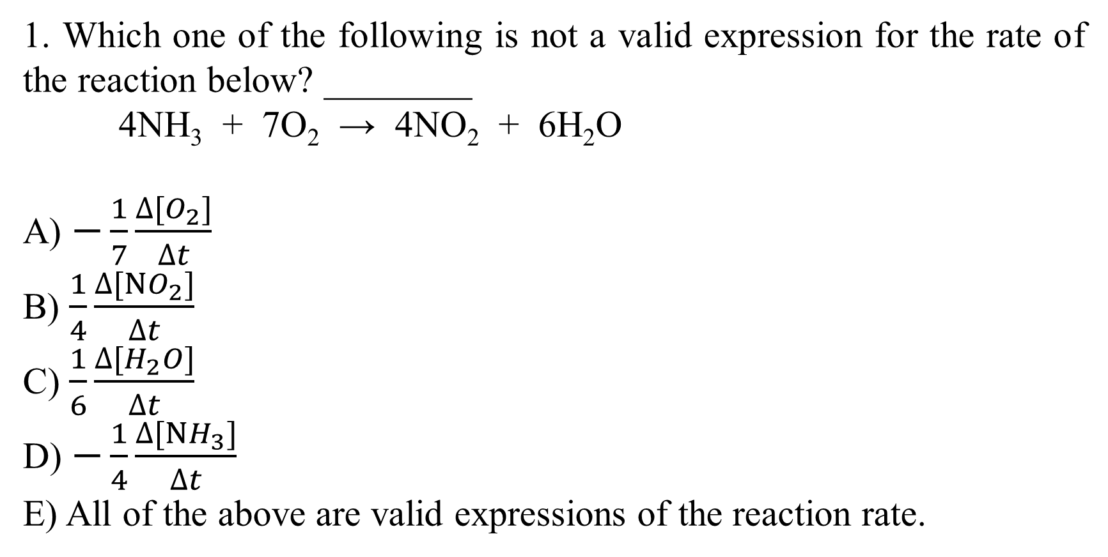
1. Which one of the following is not a valid expression for the rate of the reaction below? ________
4NH₃ + 7O₂ → 4NO₂ + 6H₂O
A) $−\frac{1}{7}\frac{∆[O_{2}]}{∆t}$
B) $\frac{1}{4}\frac{∆[NO_{2}]}{∆t}$
C) $\frac{1}{6}\frac{∆[H_{2}O]}{∆t}$
D) $−\frac{1}{4}\frac{∆[NH_{3}]}{∆t}$
E) All of the above are valid expressions of the reaction rate.

Slide 3
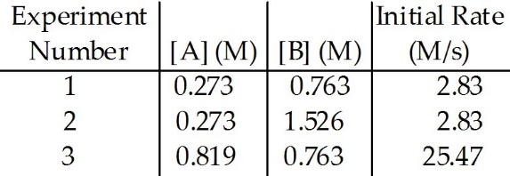
2. The data in the table below were obtained for the reaction:
A + B → P
The rate law for this reaction is rate = ________.
A) k[A][B]
B) k[P]
C) k[A]²[B]
D) k[A]²[B]²
E) k[A]²

Slide 4
3. The data in the table below were obtained for the reaction:
A + B → P
The magnitude of the rate constant is ________.
A) 38.0
B) 0.278
C) 13.2
D) 42.0
E) 2.21

Slide 5
4. The reaction：NO₂ → NO + ½ O₂
follows second-order kinetics. At 300 °C, [NO₂] drops from 0.0100 M to 0.00650 M in 100.0 s. The rate constant for the reaction is ________ M⁻¹s⁻¹.
A) 0.096
B) 0.65
C) 0.81
D) 1.2
E) 0.54

Slide 6
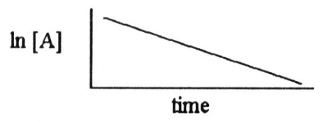
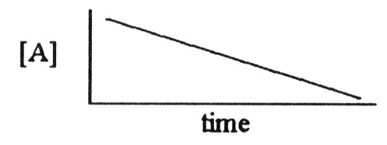
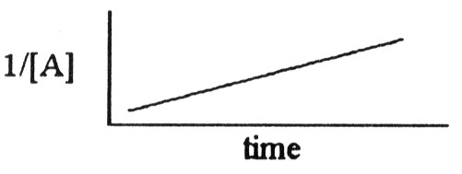
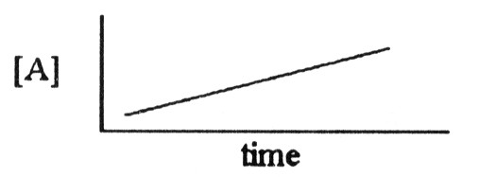
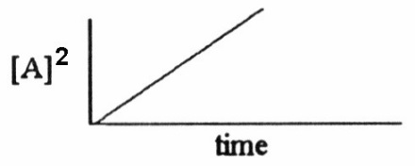
5. Which one of the following graphs shows the correct relationship between concentration and time for a reaction that is second order in [A]? ________
A) B)
C) D)
E)

Slide 7
6. The decomposition of N₂O₅ in solution in carbon tetrachloride proceeds via the reaction:
2N₂O₅ (soln) → 4NO₂ (soln) + O₂ (soln)
The reaction is first order and has a rate constant of 4.82 × 10⁻³ s⁻¹ at 64 °C. The rate law for the reaction is rate = ________.
A) k[N₂O₅]²
B)
C) k[N₂O₅]
D)
E) 2k [N₂O₅]

Slide 8
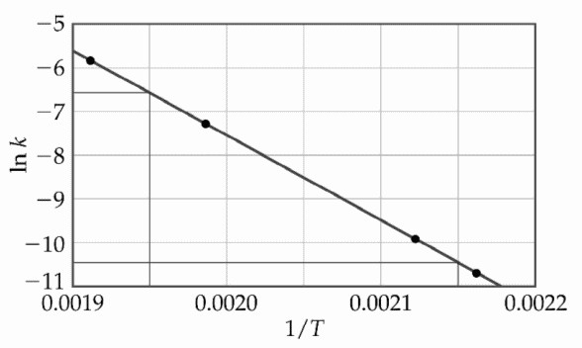
7. At elevated temperatures, methylisonitrile (CH₃NC) isomerizes to acetonitrile (CH₃CN):
CH₃NC (g) → CH₃CN (g)
The dependence of the rate constant on temperature is studied and the graph below is prepared from the results. The energy of activation of this reaction is ________ kJ/mol. R= 8.13J·mol⁻¹·K⁻¹
A) 166
B) 1.6 × 10⁵
C) 4.4 × 10⁻⁷
D) 4.4 × 10⁻⁴
E) 1.9 × 10⁴

Slide 9
Molecularity: the number of molecules that participate as reactants in an elementary reaction
8. For the elementary reaction
NO₃ + CO → NO₂ + CO₂
the molecularity of the reaction is ________, and the rate law is rate=_______
A) 2, k[NO₃][CO]
B) 4, k[NO₃][CO][NO₂][CO₂]
C) 2, k[NO₂][CO₂]
D) 2, k[NO₃][CO]/[NO₂][CO₂]
E) 4, k[NO₂][CO₂]/[NO₃][CO]

Slide 10
9. A catalyst can increase the rate of a reaction ________.
A) by changing the value of the frequency factor (A)
B) by increasing the overall activation energy (Ea) of the reaction
C) by lowering the activation energy of the reverse reaction
D) by providing an alternative pathway with a lower activation energy
E) All of these are ways that a catalyst might act to increase the rate of reaction.

